Slide 1

Electric Cars
STAT184 FINAL PROJECT
Eric, Owen, VK
07 December 2023

Slide 2
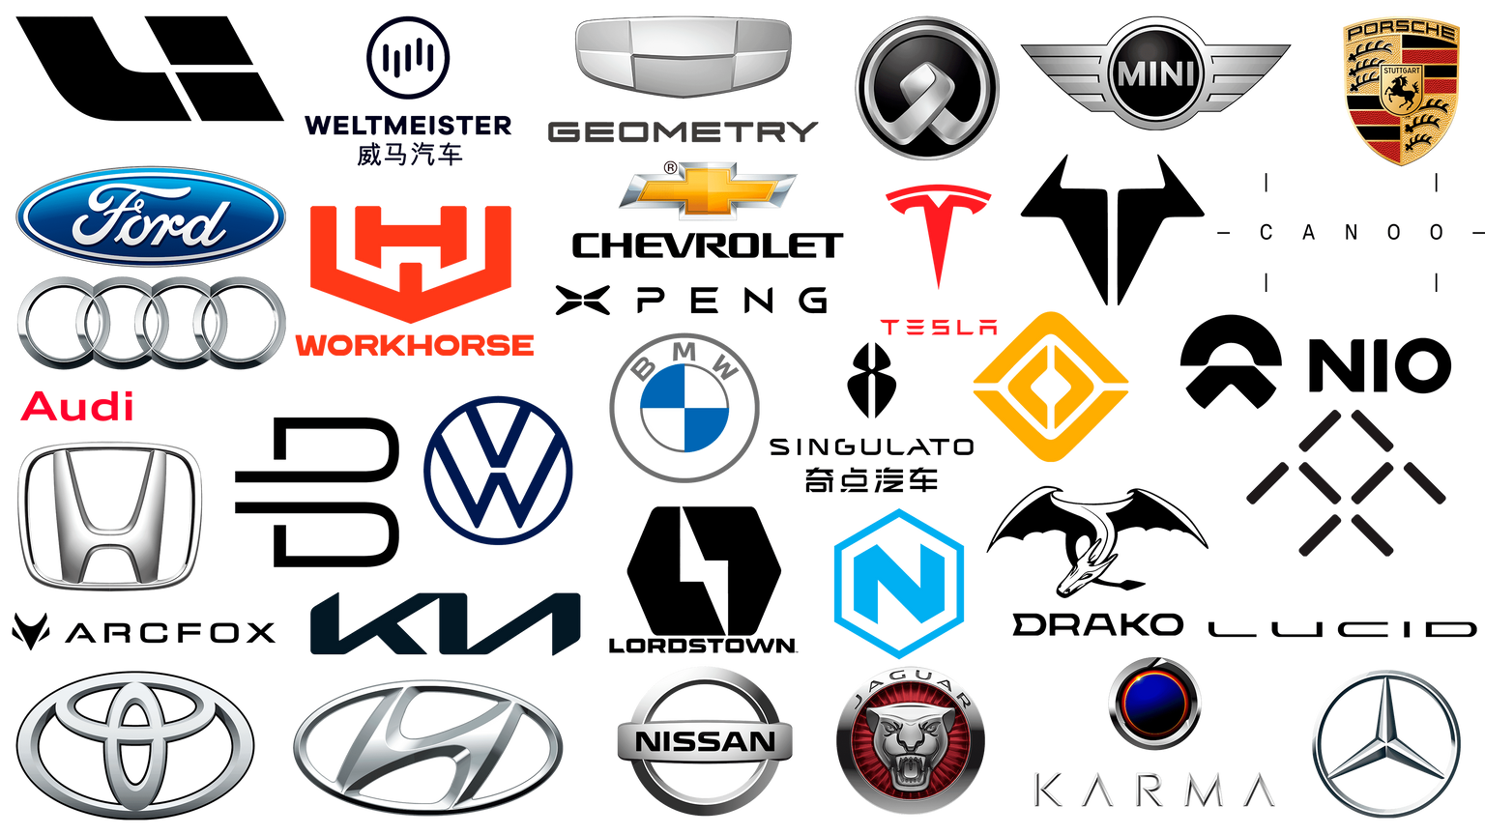
OUR FINAL PROJECT
Our group wanted to examine Electric Vehicles (EV’s). We found datasets concerning car brands as well as charging stations.
We came up with three data analysis questions, and also found an interesting outlier vehicle to compare and contrast with

Slide 3
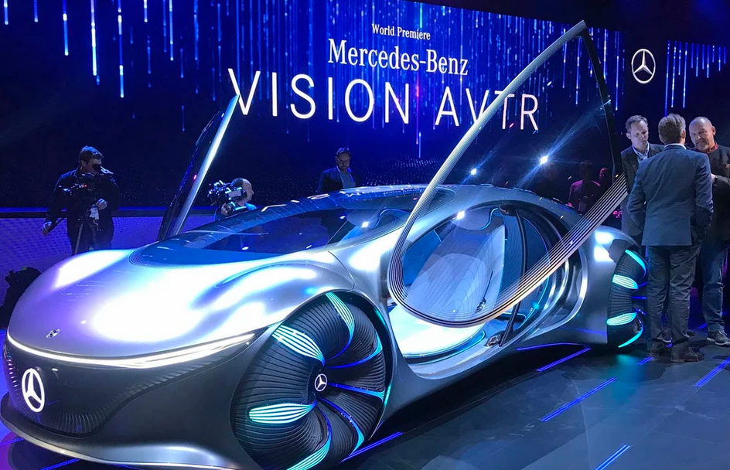
AN INTERESTING OUTLIER
What would be a “supercar” to compare with usual EV’s like the Chevrolet Bolt and Hyundai Ioniq? The Mercedes-Benz Avatar
Combined engine power of 350 kW from four separate and individually-controlled motors
Uses a new battery that doesn’t use rare earth metals and is recyclable. Battery capacity is 110 kWh and charges quickly
Has an integrated solar panel system and technology to reduce energy consumption
All-wheel drive and can conduct “Crab” movement
Interior consists of Mercedes-Benz’s most cutting edge technology. There is a steering “pad” instead of a wheel.

Slide 4
DATA ANALYSIS QUESTIONS
Question 1: How common are charging stations? We will create a Leaflet map to find the charging stations in Pennsylvania.
Question 2: What vehicle has the longest excursion time/length on a full-charge? We will create a scatter plot to examine this relationship.
Question 3: What is the most cost-efficient car? What would you buy if you had just graduated?

Slide 5

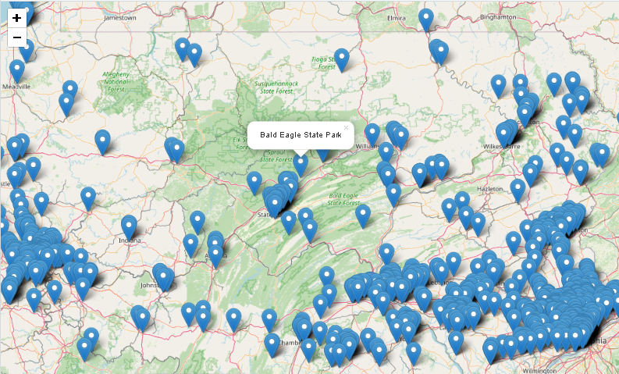
CHARGING STATIONS IN PENNSYLVANIA
Answer: We can reliably find charging stations here in PA, except in the North. We also note that typical EV’s can go 300 miles between charges.

Slide 6
EXCURSION TIMES AND OTHER FACTS

Slide 7
PICKING AN ENTRY-LEVEL ELECTRIC VEHICLE

